Slide 1

SQL Server 2008 new features
Day 1
C3: Protected

Slide 2

About the Author
Created By: | Sucharita Das (241163) & Rajalaxmi (301159)
Credential Information: | 8+ years of SQL Server developer/architect experience
Version and Date: | SS2008/0611/1.0
Cognizant Certified Official Curriculum

Slide 3









Icons Used
Hands on Exercise
Questions
Tools
Coding Standards
Test Your Understanding
Reference
A Welcome Break
Contacts
Demonstration

Slide 4
Merge statement

Slide 5
The MERGE statement basically merges data from a source result set to a target table based on a condition that you specify and if the data from the source already exists in the target or not.
The new SQL command combines the sequence of conditional INSERT, UPDATE and DELETE commands in a single atomic statement, depending on the existence of a record

Slide 6
Syntax
MERGE <target_table> [AS TARGET] USING <table_source> [AS SOURCE] ON <search_condition>
[WHEN MATCHED THEN <merge_matched> ] [WHEN NOT MATCHED [BY TARGET] THEN <merge_not_matched> ]
[WHEN NOT MATCHED BY SOURCE THEN <merge_ matched> ];

Slide 7
The MERGE statement basically works as separate insert, update, and delete statements all within the same statement.
You specify a "Source" record set and a "Target" table, and the join between the two.
You then specify the type of data modification that is to occur when the records between the two data are matched or are not matched.
MERGE is very useful, especially when it comes to loading data warehouse tables, which can be very large and require specific actions to be taken when rows are or are not present.

Slide 8
MERGE SQL statement - Part 1
--Create a target table
CREATE TABLE Products ( ProductID INT PRIMARY KEY, ProductName VARCHAR(100), Rate MONEY )
GO
--Insert records into target table
INSERT INTO Products VALUES (1, 'Tea', 10.00), (2, 'Coffee', 20.00), (3, 'Muffin', 30.00), (4, 'Biscuit', 40.00)
GO

Slide 9
--Create source table
CREATE TABLE UpdatedProducts ( ProductID INT PRIMARY KEY, ProductName VARCHAR(100), Rate MONEY )
GO
--Insert records into source table
INSERT INTO UpdatedProducts VALUES (1, 'Tea', 10.00), (2, 'Coffee', 25.00), (3, 'Muffin', 35.00), (5, 'Pizza', 60.00)
GO
SELECT * FROM Products SELECT * FROM UpdatedProducts
GO

Slide 10
MERGE SQL statement - Part 2
--Synchronize the target table with
--refreshed data from source table
MERGE Products AS TARGET USING UpdatedProducts
AS SOURCE ON (TARGET.ProductID = SOURCE.ProductID)
--When records are matched, update
--the records if there is any change
WHEN MATCHED AND
TARGET.ProductName <> SOURCE.ProductName
OR TARGET.Rate <> SOURCE.Rate THEN
UPDATE SET TARGET.ProductName = SOURCE.ProductName, TARGET.Rate = SOURCE.Rate

Slide 11
--When no records are matched, insert
--the incoming records from source
--table to target table
WHEN NOT MATCHED BY TARGET THEN
INSERT (ProductID, ProductName, Rate) VALUES (SOURCE.ProductID, SOURCE.ProductName, SOURCE.Rate)
--When there is a row that exists in target table and
--same record does not exist in source table
--then delete this record from target table

Slide 12
WHEN NOT MATCHED BY SOURCE THEN DELETE
--$action specifies a column of type nvarchar(10)
--in the OUTPUT clause that returns one of three
--values for each row: 'INSERT', 'UPDATE', or 'DELETE',
--according to the action that was performed on that row
OUTPUT $action,
DELETED.ProductID AS TargetProductID,
DELETED.ProductName AS TargetProductName,
DELETED.Rate AS TargetRate,
INSERTED.ProductID AS SourceProductID, INSERTED.ProductName AS SourceProductName,
INSERTED.Rate AS SourceRate;
SELECT @@ROWCOUNT;
GO

Slide 13
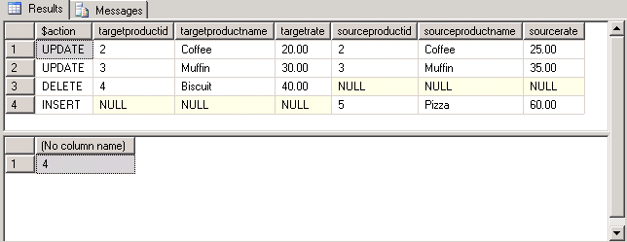
OUTPUT
There were 2 updates, 1 delete and 1 insert.

Slide 14
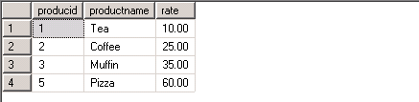
TARGET TABLE

Slide 15
POINTS TO REMEMBER
The MERGE SQL statement requires a semicolon (;) as a statement terminator.
When used after MERGE, @@ROWCOUNT returns the total number of rows inserted, updated, and deleted to the user
At least one of the three MATCHED clauses must be specified when using MERGE statement; the MATCHED clauses can be specified in any order.
However a variable cannot be updated more than once in the same MATCHED clause.

Slide 16
MERGE SQL statement improves the performance as all the data is read and processed only once whereas in previous versions three different statements have to be written to process three different activities (INSERT, UPDATE or DELETE) in which case the data in both the source and target tables are evaluated and processed multiple times.
MERGE SQL statement takes same kind of locks minus one Intent Shared (IS) Lock that was due to the select statement in the ‘IF EXISTS’ as we did in previous version of SQL Server.

Slide 17

You have successfully completed SQL Server 2008 new features
Click here to proceed

